Slide 1
Pixels to realism: technology in video games
By Christopher Rodriguez

Slide 2
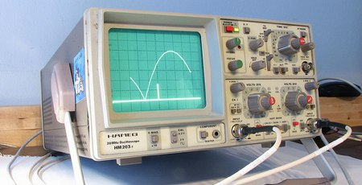
The first video game
Created in 1958
Was named “Tennis for Two”
Played on an oscilloscope
used a cathode-ray tube
Players used buttons and rotating dials
Created by William Higinbotham
https://youtu.be/6PG2mdU_i8k?si=3AFI4yx2AN_Kd0Sm

Slide 3
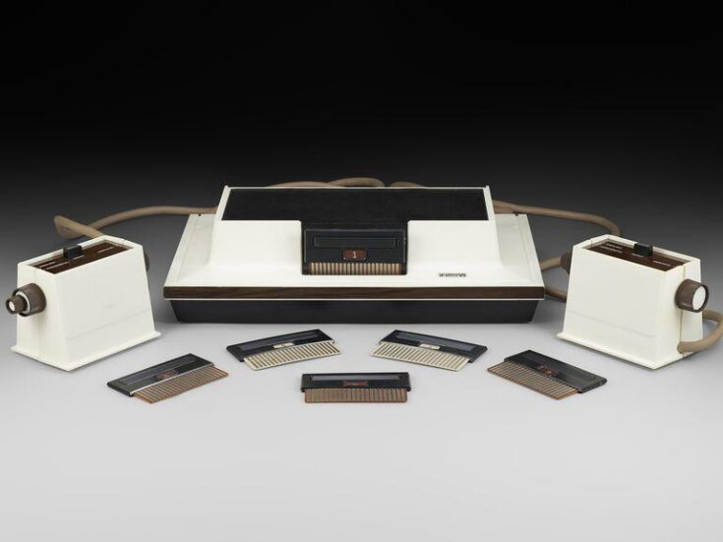
First Home Console
https://youtu.be/u24ffdOHBg8?si=UnRYopW_hFCZOshW
Released in 1972
removable printed circuit board card
polymer foil that would go on top of the television
console itself had no way of storing data for the games, only the inputs of the players
The box is made up of transistors, resistors and capacitors, the cards would change the games
Created by Ralph Baer

Slide 4
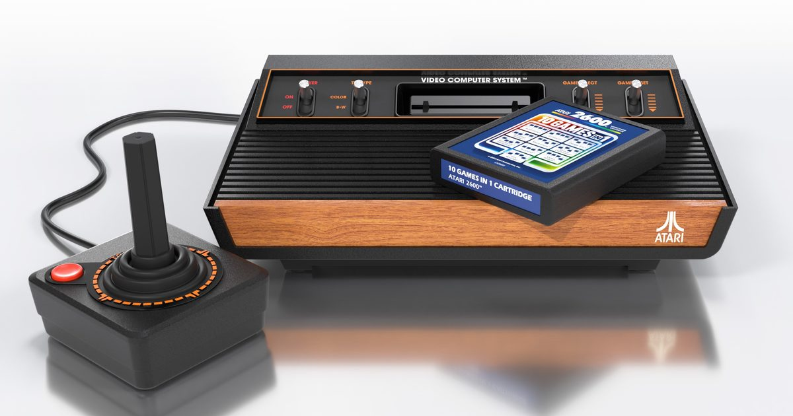
Atari’s Rise
Released in 1977
Created the Atari 2600
Cartridges would be ROM memory
Had Joystick paddles driving keypad Trak-Ball
8-bit MOS Technology 6507
128 bytes RAM
Founded by Nolan Bushnell and Ted Dabney

Slide 5
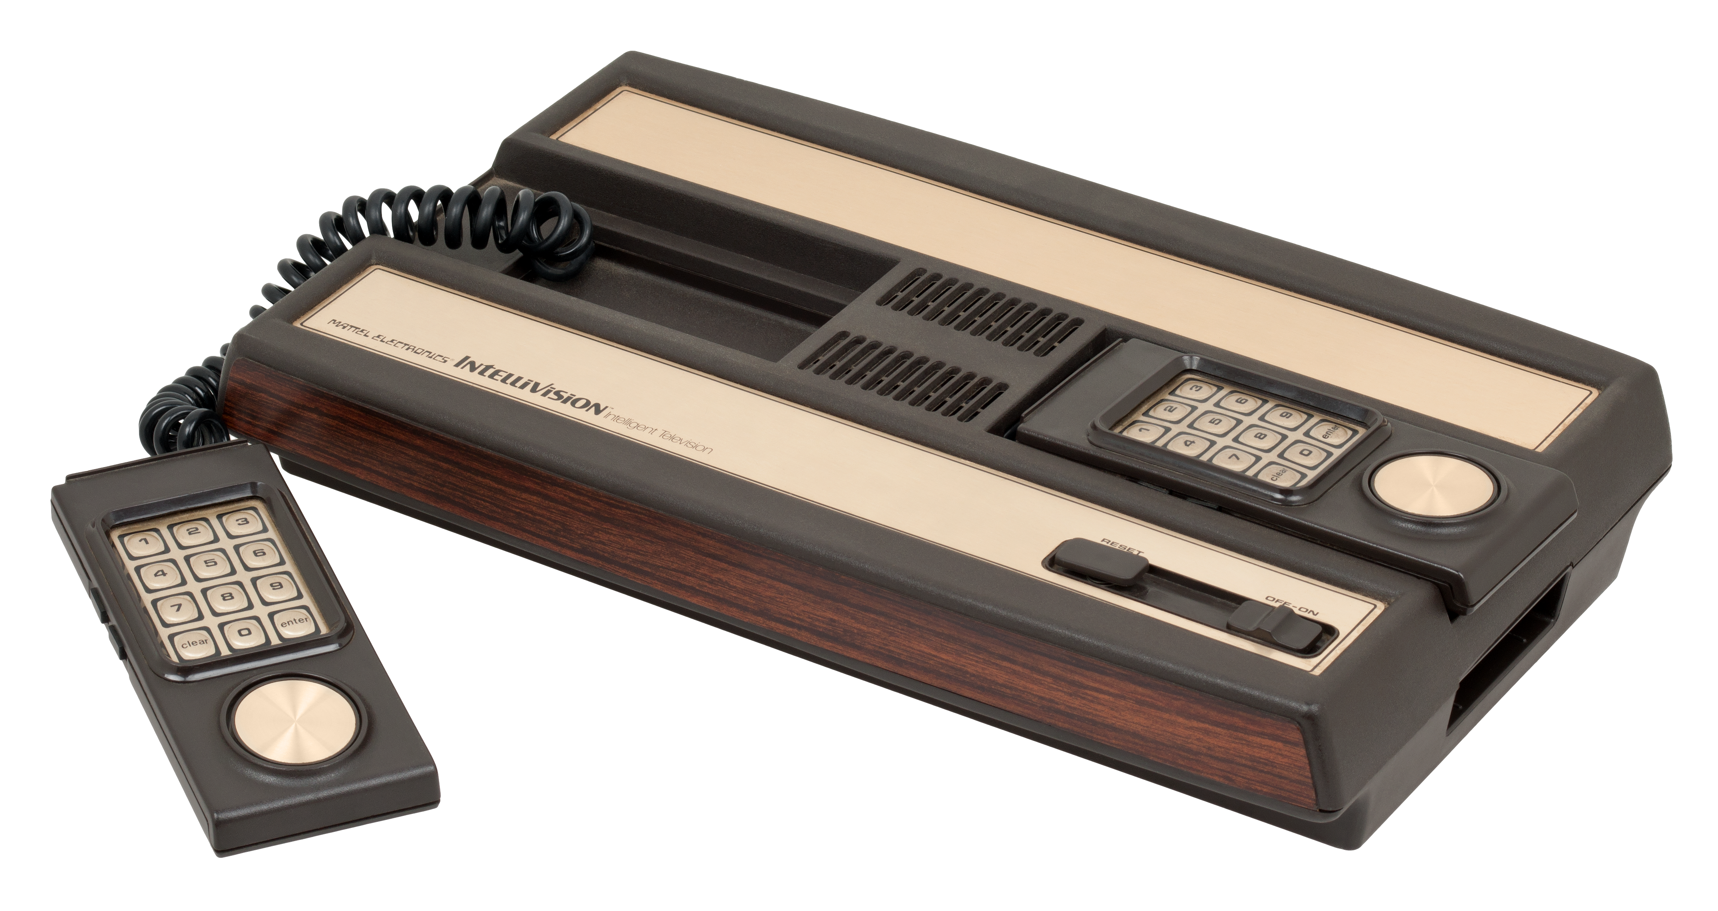
Mattel Intellivision
Released in 1979
The first 16-bit console
Also had ROM cartridges
Was promised a keyboard extension, never came out
GI CP1610 CPU (made by General Instrument)
One of the stronger consoles of the time. Went head to head with Atari
Created by Mattel

Slide 6
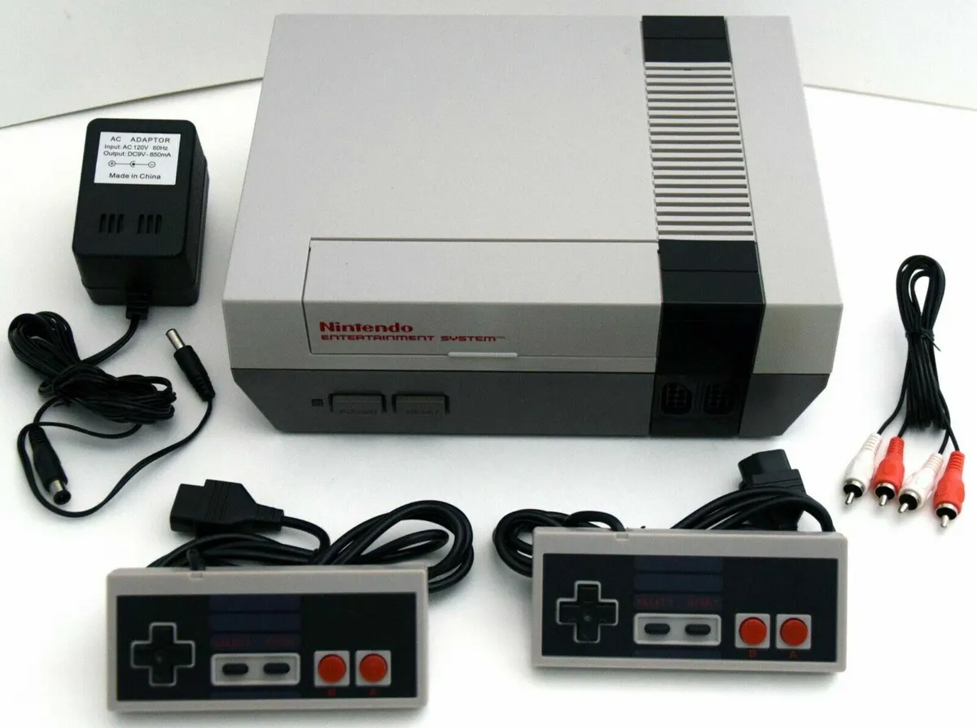
Nintendo entertainment system
Released in 1984
Has a Ricoh 2A03/2A07 CPU (same was MOS 6502)
Cartridges has 2 Rom chips (one for the GPU and one for the CPU)
Was an 8-bit console but was a fan favorite
Saved the video game crisis
Has a 256 × 240 pixels display
Tile graphics made a huge standing point for the NES
Published by Nintendo Designed by Uemura Masayuki

Slide 7
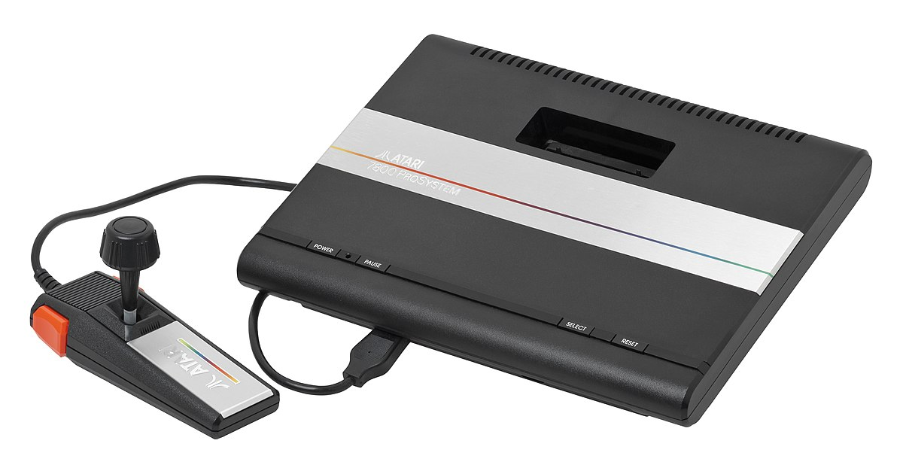
Atari 7800
Released in 1986
One of the first ever consoles to have backwards compatibility
Had a 6502 processor
"behind the time in graphical capability but was able to pump out high quality ports of golden-era arcade titles”

Slide 8
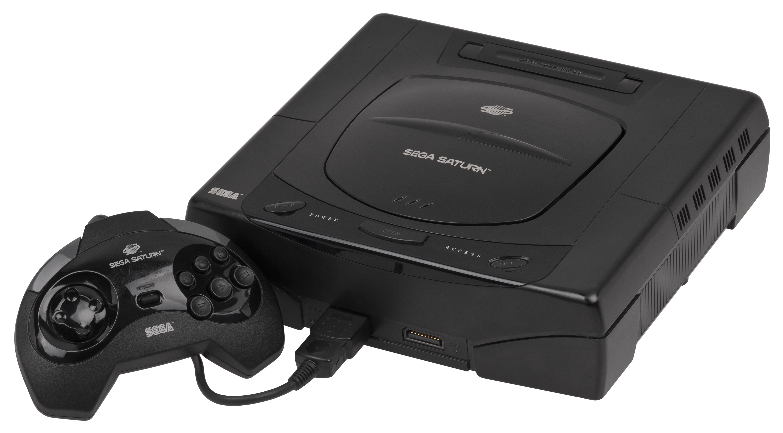
Sega Saturn
Released in 1995
Has a dual-CPU architecture and eight processors
Could read from either a cartridge or a CD
One of the first few consoles to have 3D games
Had both a 2D and a 3D processor.

Slide 9
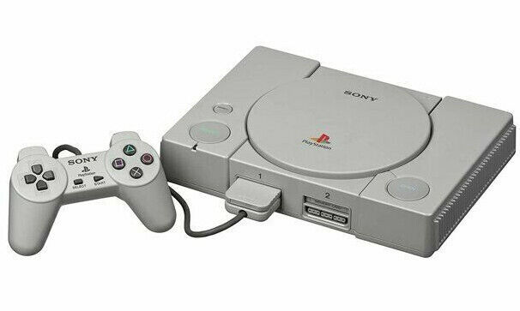
Sony Playstation
Released in 1995
Sony stepped into the gaming platform
Knocked it right out of the park with their first console
Revolutionary console
Played games in 32-bits
The game’s library of games would reign supreme
Took advantage of being able to play 3D games

Slide 10
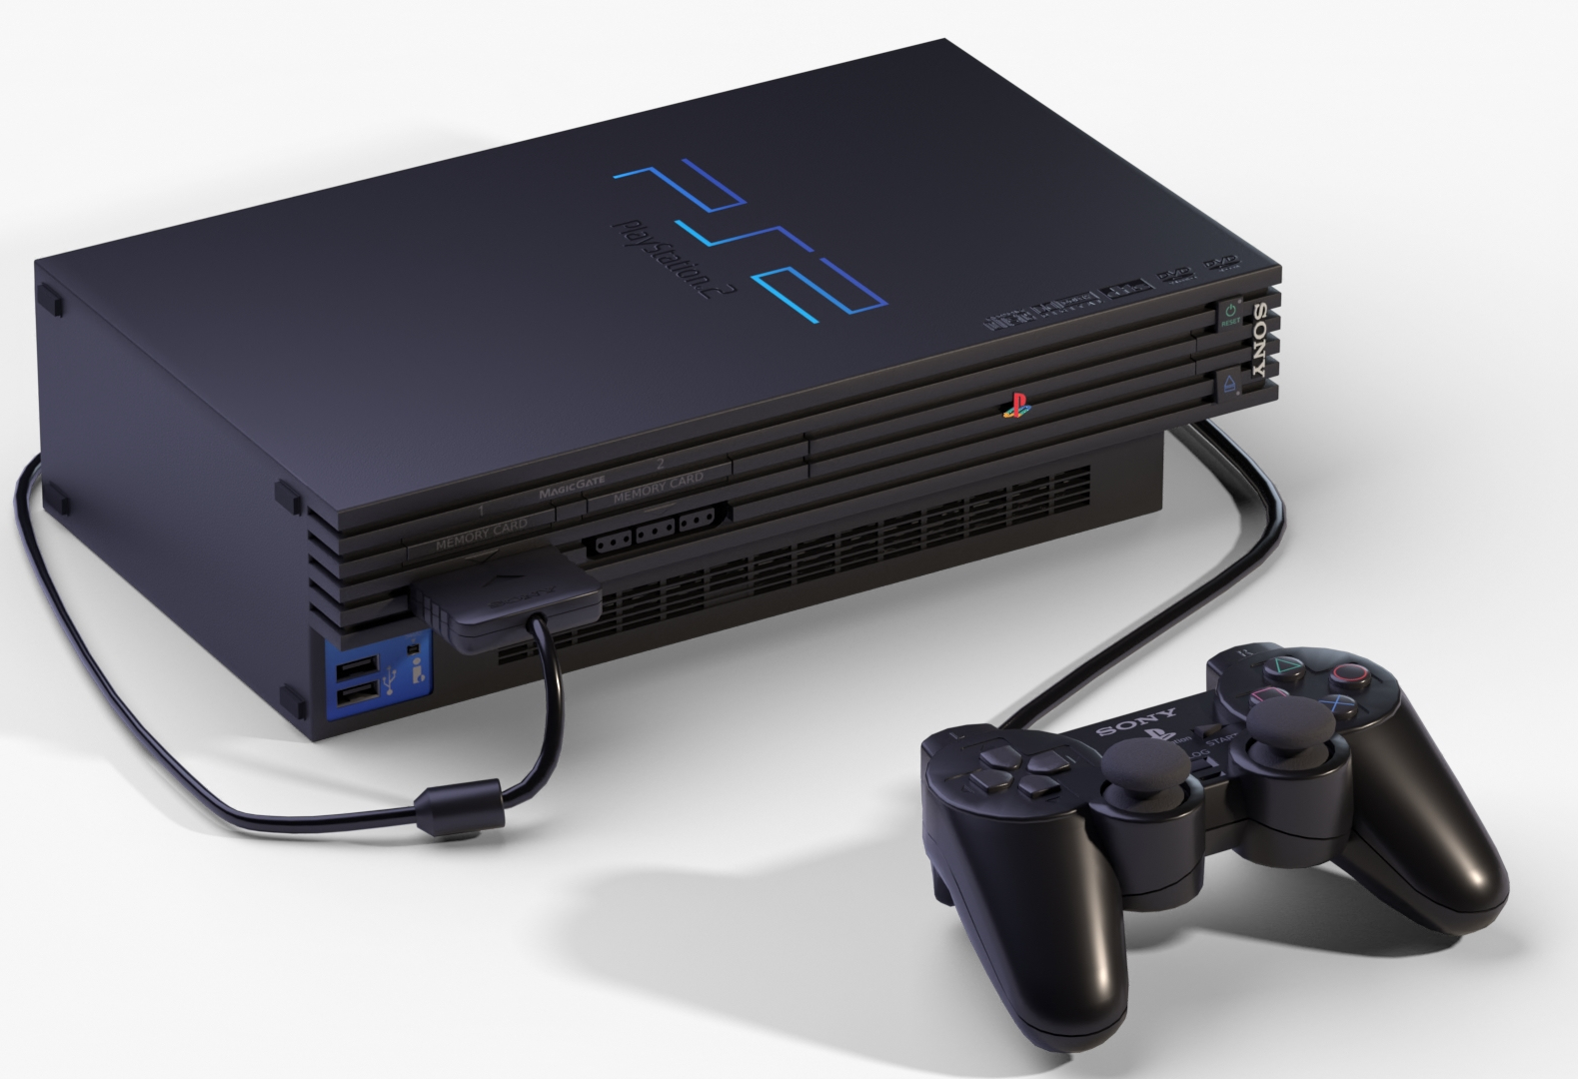
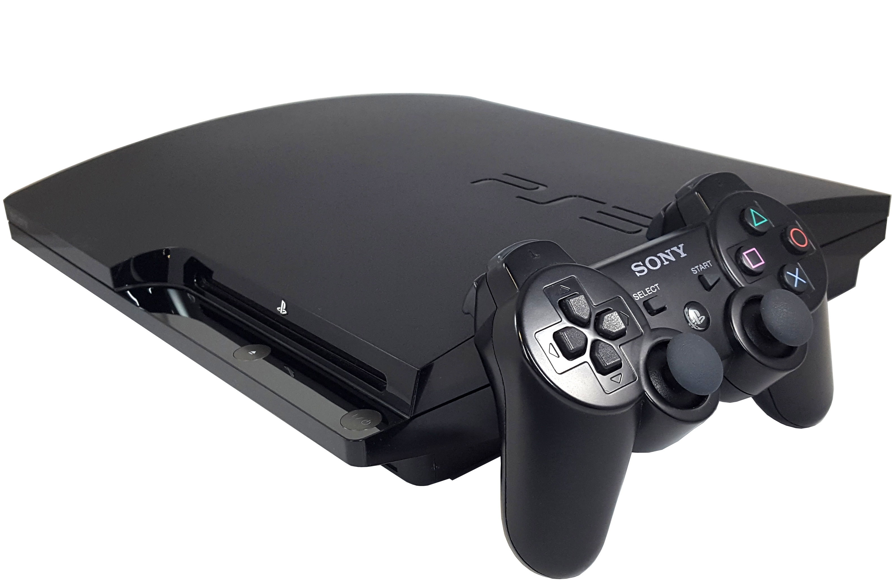
Playstation 2 /Playstation 3
Released in 2000
Had an CPU known as the Emotion Engine
Had a DvD ROM
Insane library of games
The best selling console of all time
---------------------------------------
Released in 2006
Has a 3.2 GHz IBM Cell Broadband Engine processor
Had online features called Playstation Network. Allowed online gaming
Could Stream movies

Slide 11
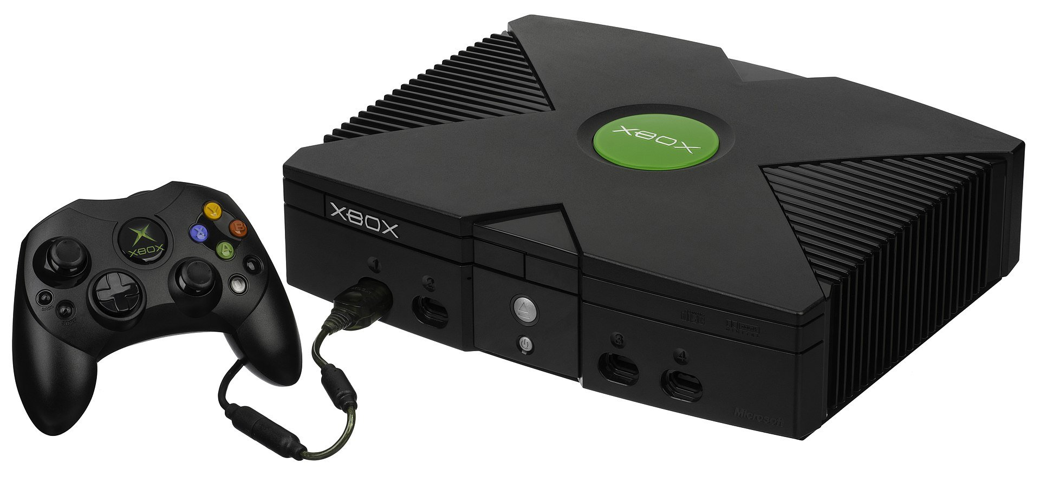
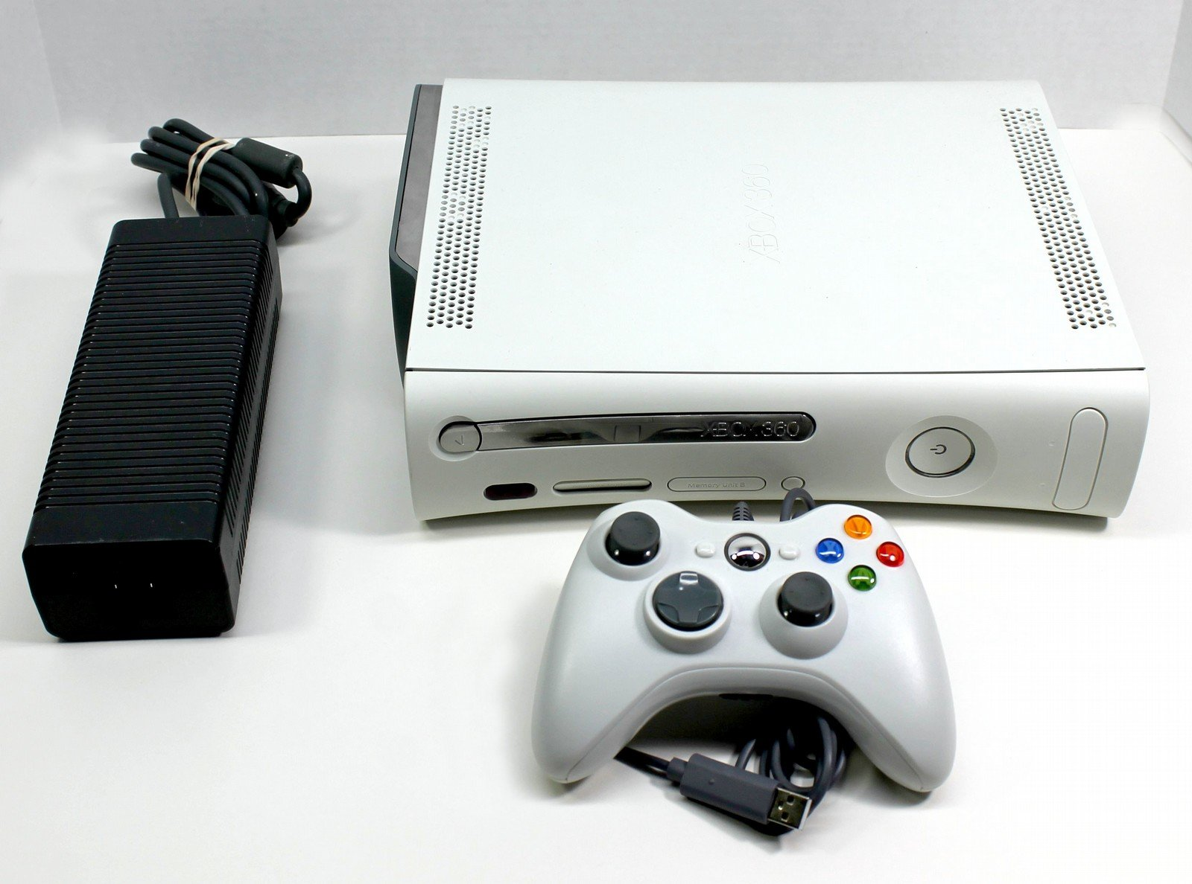
Microsoft xbox / Xbox 360
Released in 2001
Microsoft first attempt at a videogame console
Had a “32-bit 733 MHz, custom Intel Pentium III processor with 64 MB of unified DDR SDRAM”
Had a built in hard drive
Equivalent to PC of the time.
----------------------------------------------
Released in 2005
3.2 GHz PowerPC Tri-Core Xenon processor
Xbox live was one of the first online gaming network
Has a wireless controller
Was more than a gaming console, had multimedia capabilities

Slide 12
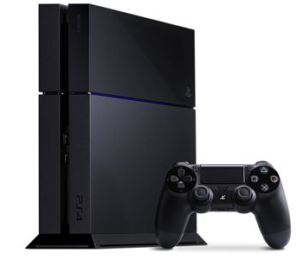
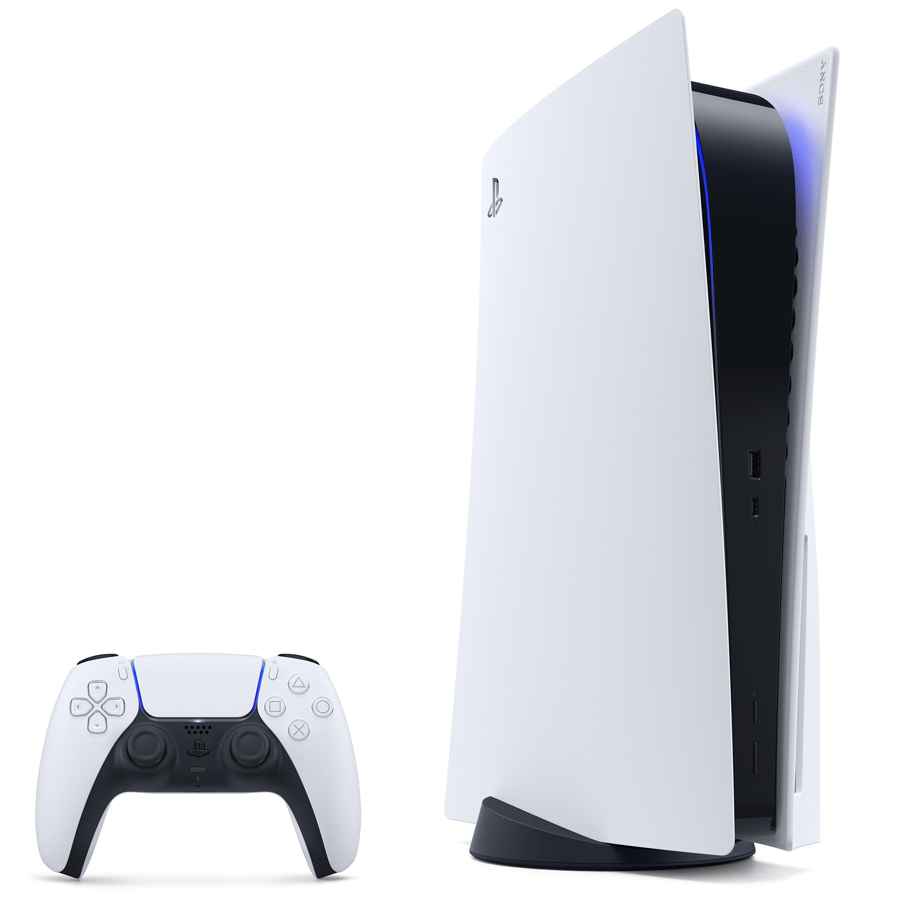
Playstation 4/5
Released in 2013
“Main processor. Single-chip custom processor. CPU : x86-64 AMD “Jaguar”, 8 cores”
Insane graphics would make this the power console of its time.
Would release a pro version that would have a stronger GPU and have a TB of storage
---------------------------------------------------
Released in 2020
The PS5 is one of the strongest consoles out to date with specs of 8 core CPUs, RNDA GPUs, blue ray disk readers, and 16gb RAM with TBs of storage
Fastest loading time for video games on the market
NVMe M.2 SSD extendable storage if desired

Slide 13
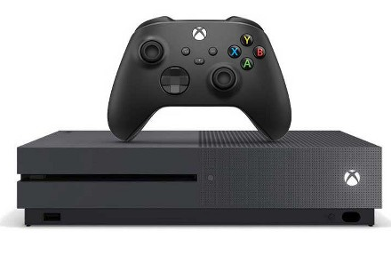
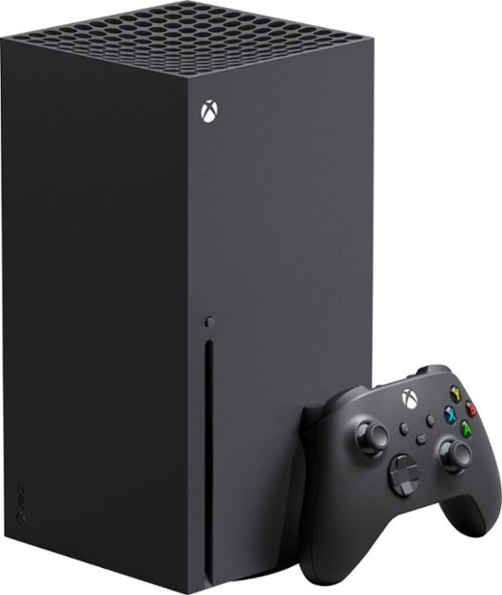
Xbox One/ Series
Released in 2013/2020 as a competitor to PS4
These consoles would have similar specs to the competitor.
Xbox would focus more on the multimedia uses of the console rather than console exclusives
Created the Xbox game pass, a subscription based catalog of games to play
Would help in the spread of cross platform play and having the option to be backwards compatible with most of Xbox’s games all the way to the original Xbox

Slide 14
Work Cited
Experience every home gaming console from the beginning. Long Island Retro Gaming Expo. (2023, April 3). https://liretro.com/console-timeline/
Nintendo history. Nintendo of Europe AG. (n.d.). https://www.nintendo.co.uk/Hardware/Nintendo-History/Nintendo-History-625945.html
History of gaming setups - 80’s, 90’s & 00’s. Hosa. (2021, May 13). https://hosatech.com/press-release/history-of-video-games/#:~:text=Dreamcast%20(~9%20million%20sold)%20%7C%20(1998)&text=The%20Dreamcast%20was%20also%20the,internet%20support%20and%20online%20play .

